Slide 1
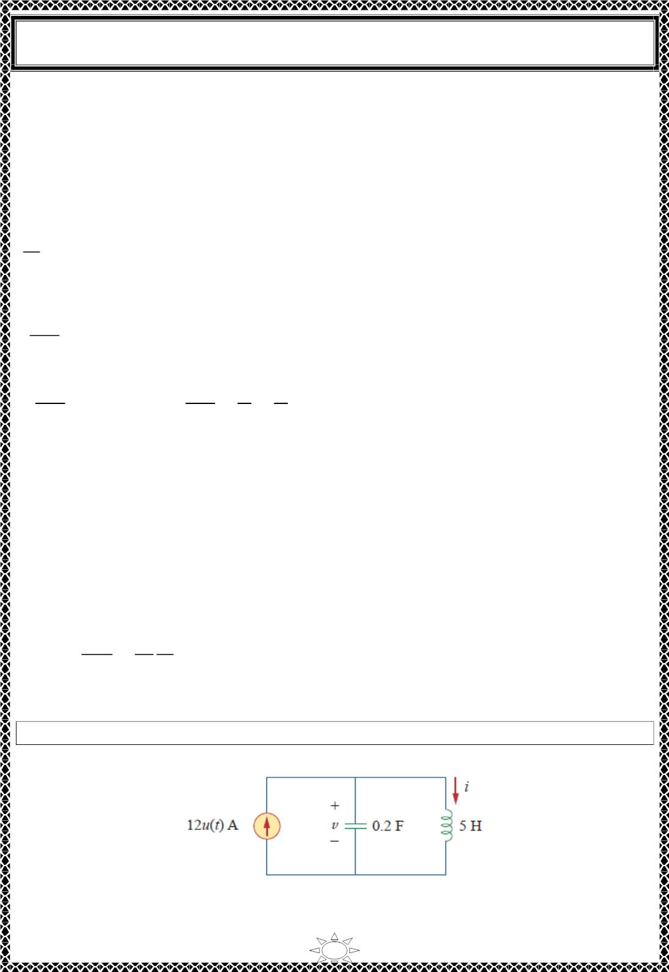
University of Diyala
Engineering College
Electrical Circuits
푖(푡) = 퐼 + 퐴 푒^{−11978ꢀ} + 퐴 푒−0.5218ꢀ
(1)
푠
1
2
where 퐼 = 4 is the final value of 푖(푡) . We now use the initial conditions to determine 퐴
푠
1
and 퐴₂. At 푡 = ꢁ,
푖(푂) = 4 = 4 + 퐴 + 퐴 ⇒ 퐴 = ꢂ퐴
1
(2)
1
2
2
Taking the derivative of 푖(푡) in Eq. (1),
푑푖
= ꢂꢃꢃ.ꢄꢅꢆ퐴 푒^{−11978ꢀ} ꢂ ꢁ.ꢇꢈꢃꢆ퐴 푒−0.5218ꢀ
푑푡
1
2
so that at 푡 = ꢁ,
ꢉꢊ(0)
= ꢂꢃꢃ.ꢄꢅꢆ퐴₁ ꢂ ꢁ.ꢇꢈꢃꢆ퐴₂
(3)
ꢉꢀ
But
ꢉꢊ(0)
ꢉꢊ(0)
ꢉꢀ
15
ꢋ
15
퐿
ꢉꢀ
= 푣(ꢁ) = ꢃꢇ ⇒
=
=
= ꢁ.ꢅꢇ
20
Substituting this into Eq. (3) and incorporating Eq. (2), we get
Trail Version
Trail Version
Trail Version
Trail Version
Trail Version
Trail Version
Trail Version
Trail Version
Trail Version
Trail Version
Trail Version
Trail Version
Trail Version
ꢁ.ꢅꢇ = (ꢃꢃ.ꢄꢅꢆ ꢂ ꢁ.ꢇꢈꢃꢆ)퐴 ⇒ 퐴 = ꢁ.ꢁ6ꢇꢇ
2
2
Thus, 퐴 = ꢂꢁ.ꢁ6ꢇꢇ and 퐴 = ꢁ.ꢁ6ꢇꢇ. Inserting 퐴 and 퐴 in Eq. (1) gives the complete
1
2
1
2
solution as
푖(푡) = 4 + ꢁ.ꢁ6ꢇꢇ(푒^{−0.5218ꢀ} ꢂ 푒^{−11978ꢀ})퐴
From 푖(푡) , we obtain 푣(푡) = 퐿푑푖/푑푡 and
푖_{푅}(푡) =
푣(푡)
ꢈꢁ
퐿 푑푖
= ꢁ.ꢅꢆꢇ푒^{−11978ꢀ} ꢂ ꢁ.ꢁ34ꢈ푒^{−0.5218ꢀ}퐴
=
ꢈꢁ 푑푡
H.W. 8: Find 푖(푡) and 푢(푡) for 푡 > ꢁ in the circuit of Fig.1.
Answer: ퟏퟐ(ퟏ ꢂ 퐜퐨퐬 풕)푨, ퟔퟎ 퐬퐢퐧 풕푽.
Fig.1
32

Slide 2
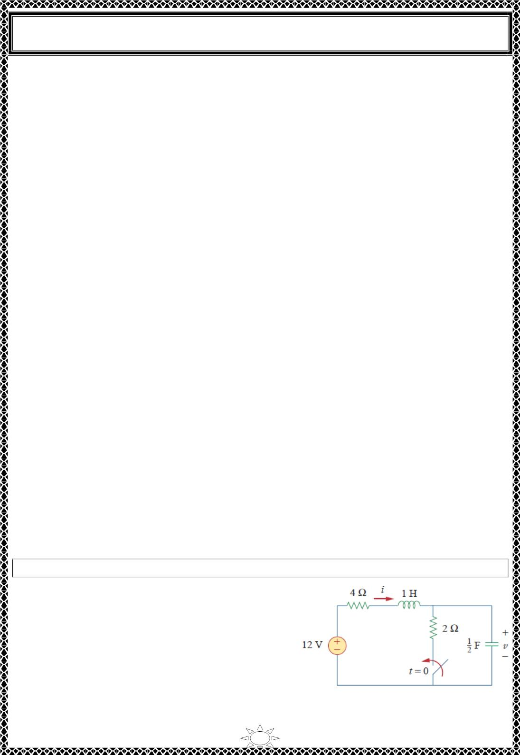
University of Diyala
Engineering College
Electrical Circuits
7) General Second‐Order Circuits
Now that we have mastered series and parallel RLC circuits, we are prepared to apply the
ideas to any second-order circuit having one or more independent sources with constant
values. Although the series and parallel RLC circuits are the second-order circuits of
greatest interest, other second-order circuits including op amps are also useful. Given a
second-order circuit, we determine its step response x(t) (which may be voltage or current)
by taking the following four steps:
1. We first determine the initial conditions 푥(푂) and 푑푥(푂)/푑푡 and the final value 푥(∞) ,
as discussed in Section 2.
2. We turn off the independent sources and find the form of the transient response 푥ꢀ(푡) by
applying KCL and KVL. Once a second‐order differential equation is obtained, we
determine its characteristic roots. Depending on whether the response is overdamped,
critically damped, or underdamped, we obtain 푥ꢀ(푡) with two unknown constants as we did
in the previous sections.
3. We obtain the steady‐state response as
Trail Version
Trail Version
Trail Version
Trail Version
Trail Version
Trail Version
Trail Version
Trail Version
Trail Version
Trail Version
Trail Version
Trail Version
Trail Version
푥_{푠푠}(푡) = 푥(∞)
(7.1)
where 푥(∞) is the final value of 푥, obtained in step 1.
4. The total response is now found as the sum of the transient response and steady‐state
response
푥(푡) = 푥 (푡) + 푥 (푡)
(7.2)
ꢀ
푠푠
We finally determine tℎ푒푐onstants associated with the transients response by imposing the
initial conditions x(0) and dx(0)/dt, determined in step 1.
We can apply this general procedure to find the step response of any second‐order circuit,
including those with op amps. The following examples illustrate the four steps.
Example 9: Find the complete response 푣 and then 푖 for 푡 > 0 in the circuit of Fig.1
Solution:
−
We first find the initial and final values. At 푡 = 0 ,
the circuit is at steady state. The switch is open; the
equivalent circuit is shown in Fig.2(a). It is evident
from the figure that
푣(0−) = 12푉,
푖(0−) = 0
Fig.1
33

Slide 3
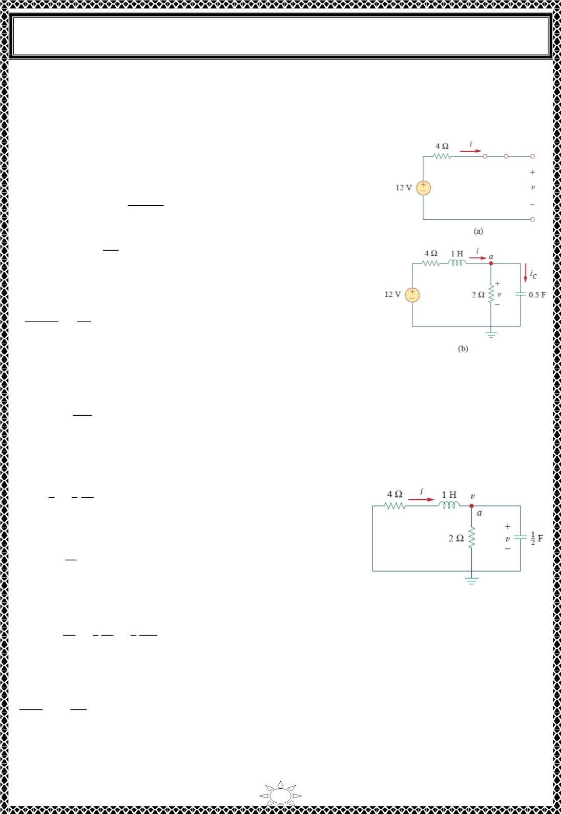
University of Diyala
Engineering College
Electrical Circuits
At 푡 = 0⁺, the switch is closed; the equivalent circuit is in Fig.2(b). By the continuity of
capacitor voltage and inductor current, we know that
푣(0+) = 푣(0−) = 12푉, 푖(0+) = 푖(0−) = 0
(1)
To get 푑푣(0^{+)/푑푡}, we use
퐶푑푢/푑푡 = 푖
푑푣/푑푡 = 푖ꢀ/퐶
.
ꢀ
or
Applying KCL at node 푎 in Fig.2(b),
푣(0+)
푖(0+) = 푖ꢀ(0+) ꢁ
2
0 = 푖ꢀ(0+) ꢁ
12
⇒ 푖ꢀ(0+) = ꢂ6퐴
2
Hence,
ꢃꢄ(ꢅ^{ꢆ})
ꢃꢇ
−ꢈ
ꢅ.5
=
= ꢂ12푉/푠
(2)
The final values are obtained when the inductor is replaced by
a short circuit and the capacitor by an open circuit in Fig.2(b),
giving
Fig.2 Equivalent circuit of
the circuit in Fig.1 for: (a)
푡 < 0, (푏)푡 > 0.
Trail Version
Trail Version
Trail Version
Trail Version
Trail Version
Trail Version
Trail Version
Trail Version
Trail Version
Trail Version
Trail Version
Trail Version
Trail Version
ꢉꢊ
푖(∞) =
= 2퐴, 푣(∞) = 2푖(∞) = ꢋ푉
(3)
4+ꢊ
Next, we obtain the form of the transient response for 푡 > 0. By turning off the 12‐푉 voltage
source, we have the circuit in Fig.3. Applying KCL at node 푎 in Fig.3 gives
ꢄ
푖 = ꢁ
ꢊ
ꢉ ꢃꢄ
ꢊ ꢃꢇ
(4)
Applying KVL to the left mesh results in
ꢃꢌ
ꢋ푖 ꢁ 1 ꢁ 푣 = 0
(5)
ꢃꢇ
Since we are interested in 푢 for the moment, we substitute
푖 from Eq. (4) into Eq. (5). We obtain
Fig.3 Obtaining the form
of the transient response
ꢃꢄ
ꢃꢇ
ꢉ ꢃꢄ
ꢊ ꢃꢇ
ꢉ ꢃ^{ꢍ}ꢄ
ꢊ ꢃꢇ^{ꢍ}
2푣 ꢁ 2
ꢁ
ꢁ
ꢁ 푣 = 0
or
푑^{ꢊ}푣
푑푡^{ꢊ}
푑푣
ꢁ ꢎ
ꢁ 6푣 = 0
푑푡
From this, we obtain the characteristic equation as
34

Slide 4
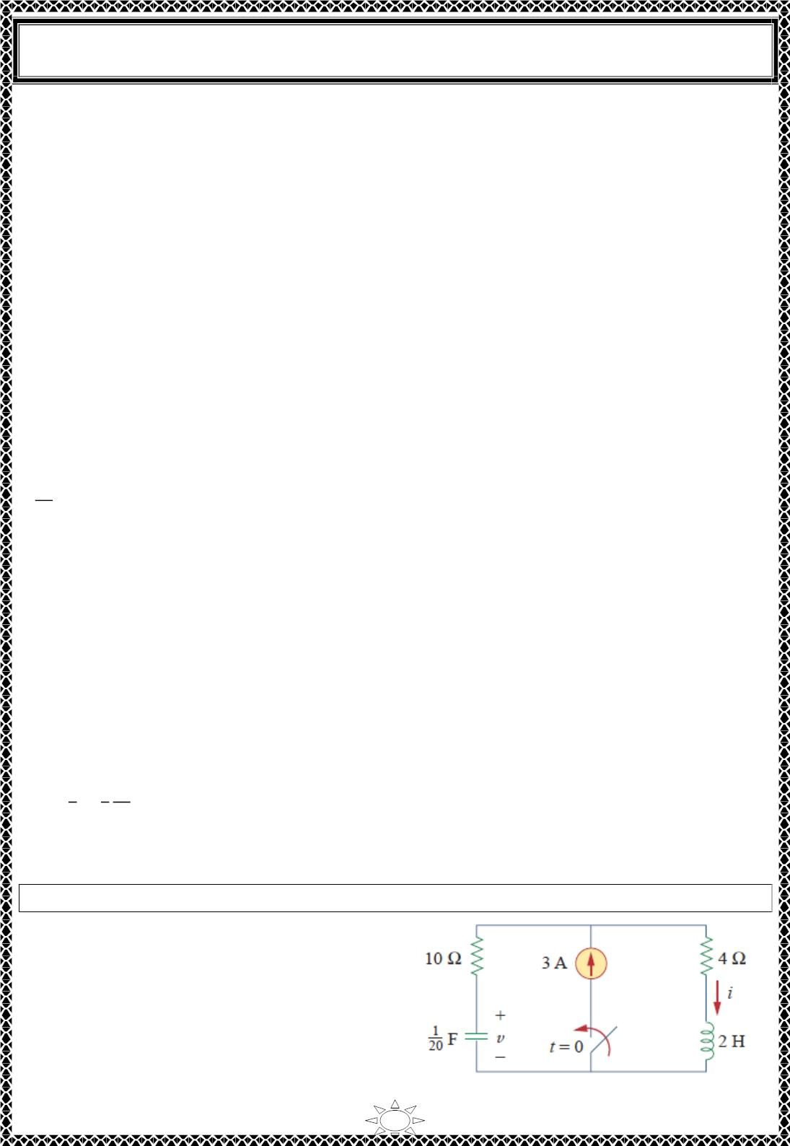
University of Diyala
Engineering College
Electrical Circuits
푠² + 5푠 + 6 = 0
with roots 푠 = −ꢀ and 푠 = −3. Thus, the natural response is
푣_{푛}(푡) = 퐴푒^{ꢁ2ꢂ} + 퐵푒^{ꢁꢃꢂ}
(6)
where 퐴 and 퐵 are unknown constants to be determined later. The steady‐state response is
푣_{ꢄꢄ}(푡) = 푣(∞) = 4
(7)
The complete response is
푣(푡) = 푣 + 푣 = 4 + 퐴푒^{ꢁ2ꢂ} + 퐵푒^{ꢁꢃꢂ}
(8)
ꢂ
ꢄꢄ
We now determine 퐴 and 퐵 using the initial values. From Eq. (1), 푣(푂) = 1ꢀ. Substituting
this into Eq. (8) at 푡 = 0 gives
1ꢀ = 4 + 퐴 + 퐵 ⇒ 퐴 + 퐵 = 8
(9)
Taking the derivative of 푣 in Eq. (8),
푑ꢅ
= −ꢀ퐴푒^{ꢁ2ꢂ} − 3퐵푒^{ꢁꢃꢂ}
(10)
(11)
푑ꢂ
Trail Version
Trail Version
Trail Version
Trail Version
Trail Version
Trail Version
Trail Version
Trail Version
Trail Version
Trail Version
Trail Version
Trail Version
Trail Version
Substituting Eq.(2) into Eq.(10), at t=0 gives
−1ꢀ = −ꢀ퐴 − 3퐵 ⇒ ꢀ퐴 + 3퐵 = 1ꢀ
From Eqs. (9) and (11), we obtain
퐴 = 1ꢀ,
퐵 = −4
so that Eq. (8) becomes
푣(푡) = 4 + 1ꢀ푒^{ꢁ2ꢂ} − 4푒^{ꢁꢃꢂ}푉,
푡 > 0
(12)
From 푣, we can obtain other quantities of interest by referring to Fig.2(b). To obtain 푖, for
example,
ꢅ
푖 = +
2
ꢆ 푑ꢅ
2 푑ꢂ
= ꢀ + 6푒^{ꢁ2ꢂ} − ꢀ푒^{ꢁꢃꢂ} − 1ꢀ푒^{ꢁ2ꢂ} + 6푒^{ꢁꢃꢂ}
푡 > 0
(13)
= ꢀ − 6푒^{ꢁ2ꢂ} + 4푒^{ꢁꢃꢂ}퐴,
Notice that 푖(푂) = 0, in agreement with Eq. (1).
H.W. 9: Determine 푣 and 푖 for 푡 > 0 in the circuit of Fig.1.
_{Answer: ퟏퟐ(ퟏ − 풆}^{ꢁퟓ풕})푽, ퟑ(ퟏ − 풆^{ꢁퟓ풕})푨.
35

Slide 5
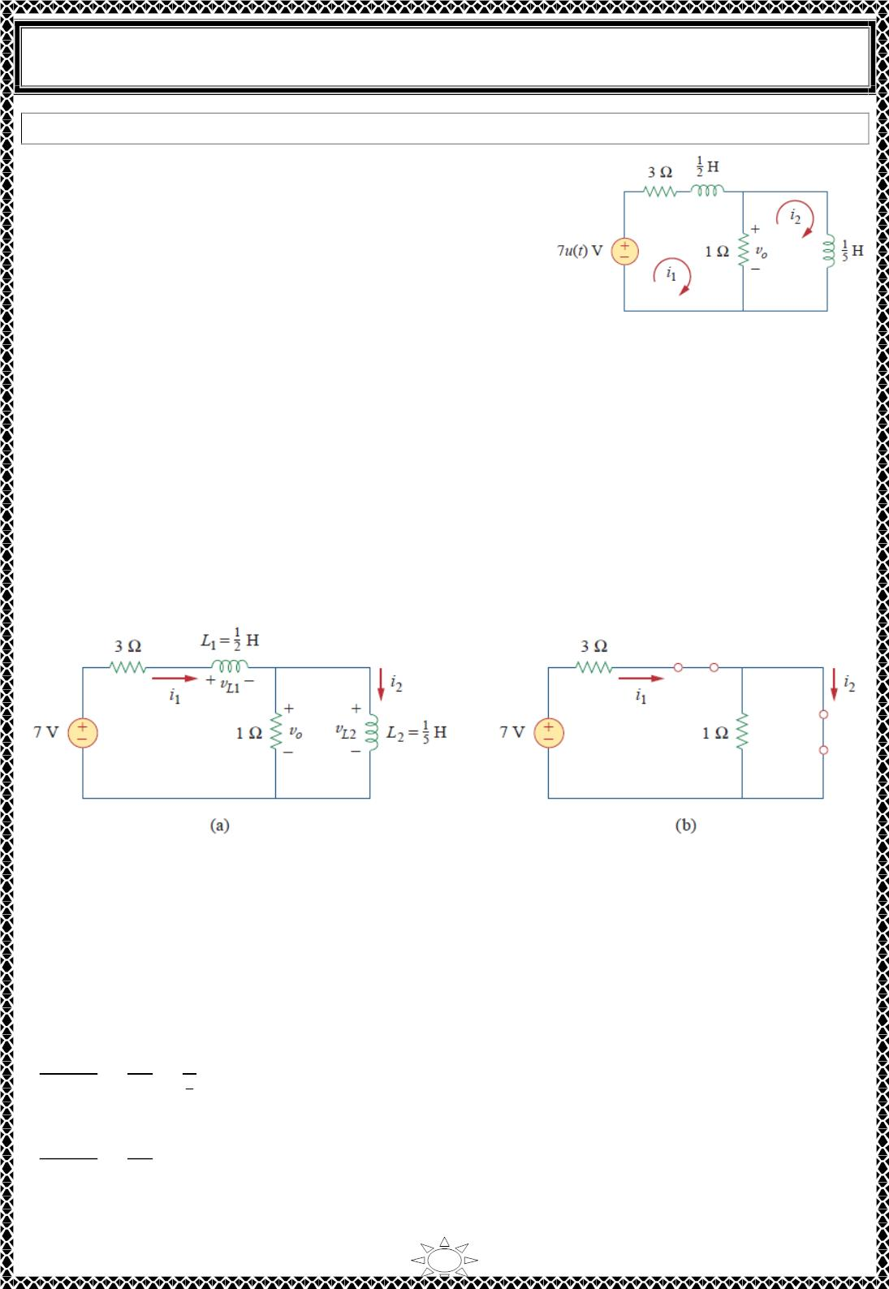
University of Diyala
Engineering College
Electrical Circuits
Example 10: Find 푣_{표}(푡) for 푡 > 0 in the circuit of Fig.1.
Solution:
This is an example of a second‐order circuit with two
inductors. We first obtain the mesh currents 푖 and 푖 ,
1
2
which happen to be the currents through the inductors.
We need to obtain the initial and final values of these
currents.
For 푡 < 0, 7푢(푡) = 0, so that 푖₁(0^{−) = 0 = 푖}₂⁽⁰⁻⁾
.
Fig.1
For 푡 > 0, 7푢(푡) = 7, so that the equivalent circuit is as shown in Fig.2(a). Due to the
continuity of inductor current,
푖 (0+) = 푖 (0−) = 0, 푖 (0+) = 푖 (0−) = 0
(1)
(2)
1
1
2
2
푣 (0+) = 푣 (0+) = ꢁ[(푖 (0+) ꢂ 푖 (0+)] = 0
퐿
ꢀ
표
1
2
Applying KVL to the left loop in Fig.2(a) at 푡 = 0^{+,}
7 = 3푖 (0+) ꢃ 푣 (0+) ꢃ 푣 (0+)
Trail Version
Trail Version
Trail Version
Trail Version
Trail Version
Trail Version
Trail Version
Trail Version
Trail Version
Trail Version
Trail Version
Trail Version
1
Trail Version
퐿
ꢄ
표
Fig.2 Equivalent circuit of that in Fig.1 for: (a) 푡 > 0, (푏)푡 → ∞.
or
푣 (0+) = 7푉
퐿
ꢄ
Since ꢅ 푑푖 /푑푡 = 푣 ,
1
1
퐿
ꢄ
ꢉ
^{ꢋ}ꢌꢄ
퐿_{ꢄ}
ꢆꢇ (ꢈ )
ꢍ
ꢄ
ꢀ
ꢄ
=
=
= ꢁ4푉/푠
(3)
(4)
ꢆꢊ
Similarly, since ꢅ 푑푖 /푑푡 = 푣 ,
ꢉ
^{ꢋ}ꢌꢀ
2
2
퐿
ꢀ
ꢆꢇ (ꢈ )
ꢀ
=
= 0
ꢆꢊ
퐿ꢀ
36

Slide 6
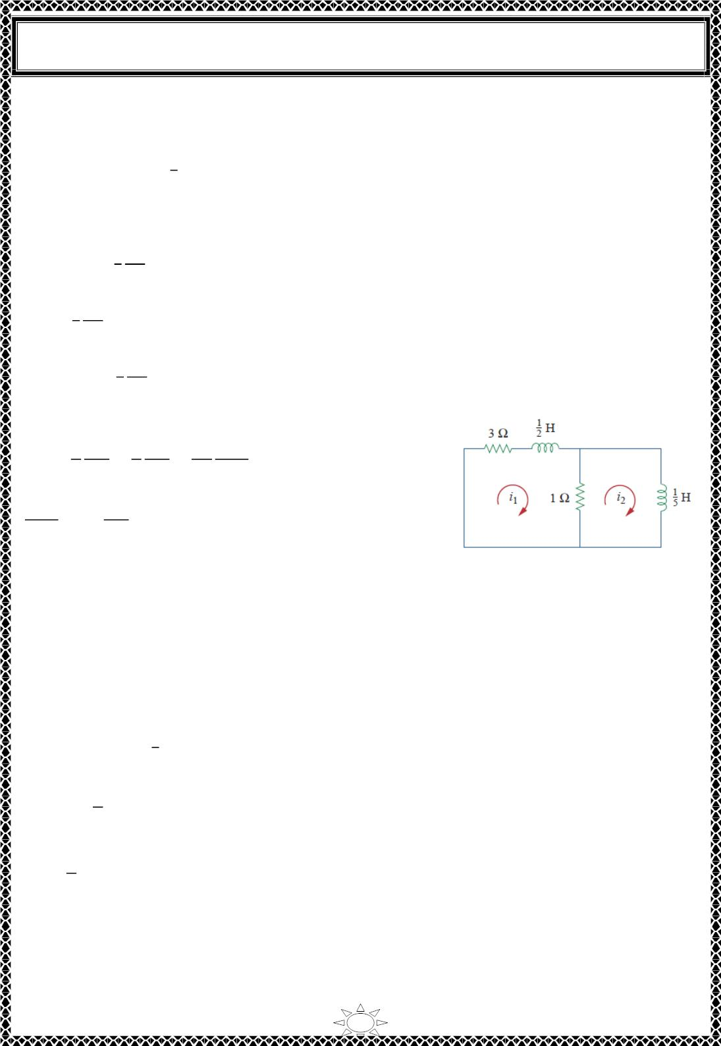
University of Diyala
Engineering College
Electrical Circuits
As 푡 → ∞, the circuit reaches steady state, and the inductors can be replaced by short
circuits, as shown in Fig.2 (b). From this figure,
7
푖 (∞) = 푖 (∞) = 퐴
(5)
1
2
3
Next, we obtain the form of the transient responses by removing the voltage source, as
shown in Fig.3. Applying KVL to the two meshes yields
4푖 − 푖 +
^{1 푑ꢀ}ꢁ
2 푑ꢂ
= 0
(6)
(7)
(8)
1
2
and
푖₂ +
^{1 푑ꢀ}ꢃ
5 푑ꢂ
− 푖₁ = 0
From Eq. (6),
푖 = 4푖 +
^{1 푑ꢀ}ꢁ
2 푑ꢂ
2
1
Substituting Eq. (8) into Eq. (7) gives
ꢄ ꢆ²푖₁
4푖₁ +
ꢆ²푖₁
ꢄ ꢆ푖₁ 4 ꢆ푖₁
ꢅ ꢆ푡 ꢇ ꢆ푡 ꢄ0 ꢆ푡²
+
+
− 푖₁ = 0
Trail Version
Trail Version
Trail Version
Trail Version
Trail Version
Trail Version
Trail Version
Trail Version
Trail Version
Trail Version
Trail Version
Trail Version
Trail Version
+ ꢄꢈ
ꢆ푖₁
ꢆ푡
+ ꢈ0푖₁ = 0
ꢆ푡²
From this we obtain the characteristic equation as
Fig.3 Obtaining the form
of the transient response
푠² + ꢄꢈ푠 + ꢈ0 = 0
which has roots 푠 = −ꢈ and 푠 = −ꢄ0. Hence, the form of the transient response is
푖_{1푛} = 퐴푒^{ꢉ3ꢂ} + 퐵푒^{ꢉ1ꢊꢂ}
(9)
where 퐴 and 퐵 are constants. The steady‐state response is
7
푖_{1ꢋꢋ} = 푖 (∞) = 퐴
(10)
(11)
1
3
From Eqs. (9) and (10), we obtain the complete response as
ꢌ
푖 (푡) = + 퐴푒^{ꢉ3ꢂ} + 퐵푒^{ꢉ1ꢊꢂ}
1
ꢈ
We finally obtain 퐴 and 퐵 ffom the initial values. From Eqs. (1) and (11),
ꢌ
0 = + 퐴 + 퐵
(12)
ꢈ
Taking the derivative of Eq. (11), setting 푡 = 0 in the derivative, and enforcing Eq. (3), we
obtain
ꢄ4 = −ꢈ퐴 − ꢄ0퐵
(13)
From Eqs. (12) and (13), 퐴 = −4/ꢈ and 퐵 = −ꢄ. Thus,
37

Slide 7
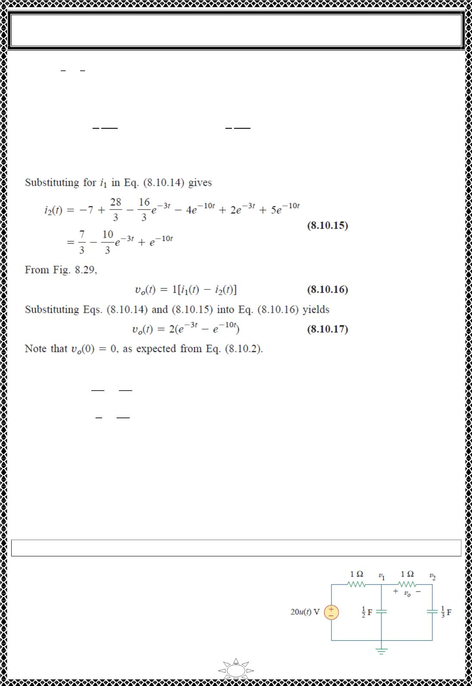
University of Diyala
Engineering College
Electrical Circuits
7
4
푖 (푡) = − 푒^{ꢀ3ꢁ} −푒^{ꢀ10ꢁ}
(14)
1
3
3
We now obtain 푖 from 푖 . Applying KVL to the left loop in Fig.2 (a) gives
2
1
ꢂ = ꢃ푖 − 푖 +
ꢄ 푑푖₁
ꢅ 푑푡
⇒ 푖 = −ꢂ + ꢃ푖 +
ꢄ 푑푖₁
ꢅ 푑푡
1
2
2
1
Substituting for 푖₁ in Eq. (14) gives
Trail Version
Trail Version
Trail Version
Trail Version
Trail Version
Trail Version
Trail Version
Trail Version
Trail Version
Trail Version
Trail Version
Trail Version
Trail Version
푖₂(푡) = −ꢂ +
ꢅ8 ꢄ6
푒^{ꢀ3ꢁ} − ꢃ푒^{ꢀ10ꢁ} + ꢅ푒^{ꢀ3ꢁ} + 5푒^{ꢀ10ꢁ}
ꢆ
−
ꢆ
(15)
ꢂ
ꢄꢇ
= −
푒^{ꢀ3ꢁ} + 푒^{ꢀ10ꢁ}
From Fig.1,
ꢆ
ꢆ
푣 (푡) = ꢄ[푖 (푡) − 푖 (푡)]
Substituting Eqs. (14) and (15) into Eq. (16) yields
푣_{표}(푡) = ꢅ(푒^{ꢀ3ꢁ} − 푒^{ꢀ10ꢁ})
(16)
(17)
표
1
2
Note that 푣_{표}(ꢇ) = ꢇ, as expected from Eq. (2).
H.W. 10: For 푡 > ꢇ, obtain 푣 (푡) in the circuit of Fig.1. (Hint: First find 푣 and 푣 . )
표
1
2
_{Answer: ퟖ(풆}^{ꢀ풕} − 풆^{ꢀퟔ풕})푽, 풕 > ퟎ.
38

